Slide 1
Optimization Algorithms

Slide 2
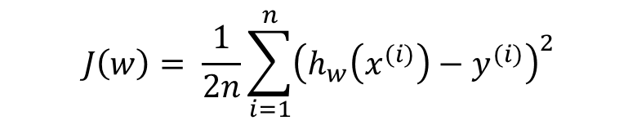
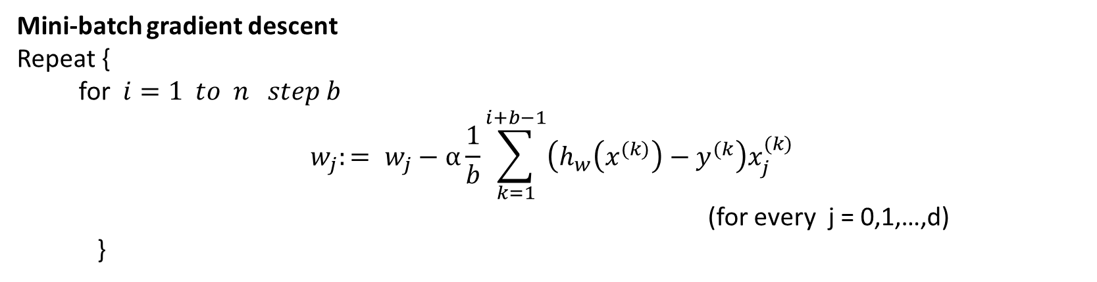
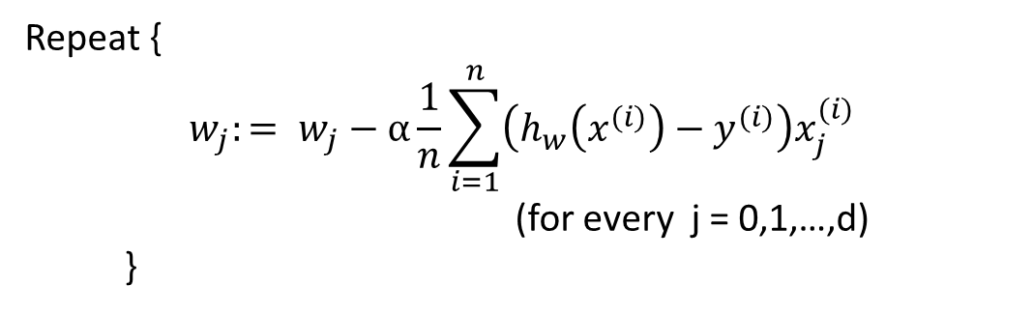
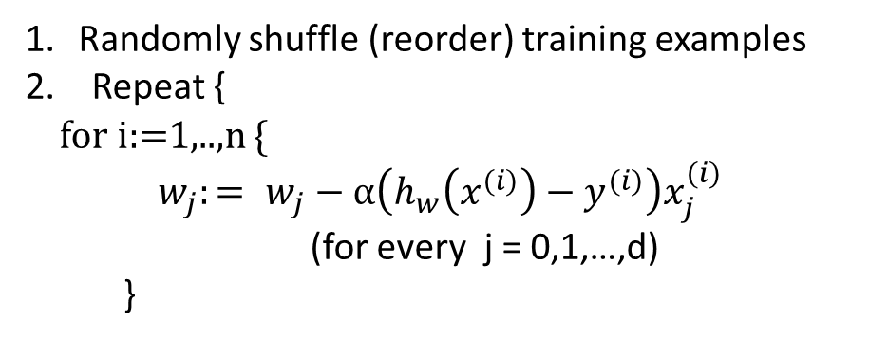
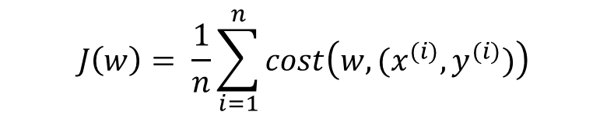
Batch gradient descent for Linear Regression
Stochastic gradient descent
$$cost\left(w,{(x}^{(i)},y^{(i)})\right)= \frac{1}{2}{\left(h_{w}\left(x^{(i)}\right)−y^{(i)}\right)}^{2}$$
$$J\left(w\right)= \frac{1}{2n}\sum_{i=1}^{n}{{\left(h_{w}\left(x^{(i)}\right)−y^{(i)}\right)}^{2}}$$
$$J\left(w\right)= \frac{1}{n}\sum_{i=1}^{n}{cost\left(w,{(x}^{(i)},y^{(i)})\right)}$$
Repeat {
$$w_{j}:= w_{j}−α\frac{1}{n}\sum_{i=1}^{n}{\left(h_{w}\left(x^{(i)}\right)−y^{(i)}\right)x_{j}^{(i)}}$$
(for every j = 0,1,…,d)
}
Randomly shuffle (reorder) training examples
2. Repeat {
for i:=1,..,n {
$$w_{j}:= w_{j}−α\left(h_{w}\left(x^{(i)}\right)−y^{(i)}\right)x_{j}^{(i)}$$
(for every j = 0,1,…,d)
}
Mini-batch gradient descent
Repeat {
for $i=1 to n step b$
$$w_{j}:= w_{j}−α\frac{1}{b}\sum_{k=1}^{i+b−1}{\left(h_{w}\left(x^{(k)}\right)−y^{(k}\right)x_{j}^{(k)}}$$
(for every j = 0,1,…,d)
}
Andrew Ng

Slide 3
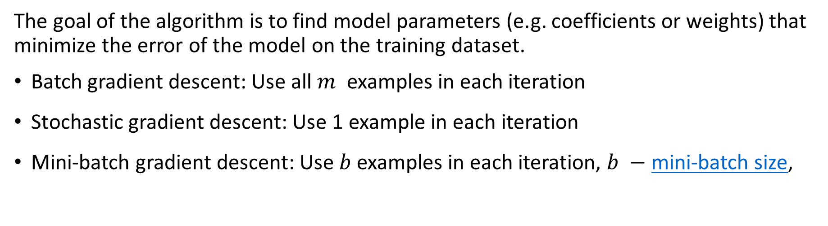
Gradient Descent
The goal of the algorithm is to find model parameters (e.g. coefficients or weights) that minimize the error of the model on the training dataset.
Batch gradient descent: Use all $m$ examples in each iteration
Stochastic gradient descent: Use 1 example in each iteration
Mini-batch gradient descent: Use $b$examples in each iteration, $b −$ mini-batch size,
Stochastic gradient descent (one epoch)
Take an example
Feed it to Neural Network
Calculate it’s gradient
Update the weights
Repeat steps 1–4 for all the examples in training dataset
Mini-batch gradient descent (one epoch)
Pick a mini-batch
Feed it to Neural Network
Calculate the mean gradient of the mini-batch
Use the mean gradient and update the weights
Repeat steps 1–4 for the all mini-batches we created

Slide 4
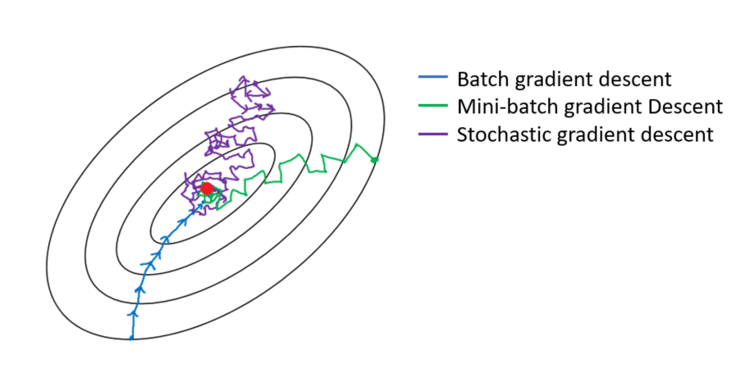
Comparison
Batch gradient descent: Too long per iteration
Stochastic gradient descent: Lose speedup from vectorization
Mini-batch gradient descent: Fastest learning( Vectorization, Make progress without processing entire training set)

Slide 5
How to Configure Mini-Batch Gradient Descent
If small training set: use batch gradient descent
Typical mini-batch sizes: 32, 64, 128, 256, 512, 1024
A good default for batch size might be 32.
It is a good idea to review learning curves of model validation error against training time with different batch sizes when tuning the batch size.
Tune batch size and learning rate after tuning all other hyperparameters.
Make sure all mini-batch fits CPU/GPU memory
Yoshua Bengio. Practical recommendations for gradient-based training of deep architectures.2012.
Dominic Masters, Carlo Luschi. Revisiting Small Batch Training for Deep Neural Networks.2018

Slide 6
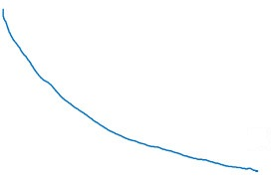
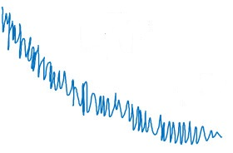

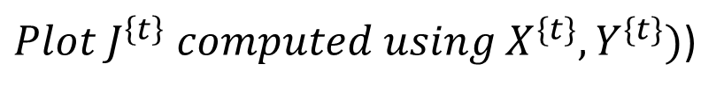

Training with mini batch gradient descent
Batch gradient descent
Mini-batch gradient descent
cost
cost
$$J$$
$$J^{\{t\}}$$
# iterations
mini batch # (t)
${Plot J}^{\left\{t\right\}} computed using X^{\{t\}},Y^{\{t\}})$)

Slide 7
Question. Which of these statements about mini-batch gradient descent do you agree with?
You should implement mini-batch gradient descent without an explicit for-loop over different mini-batches, so that the algorithm processes all mini-batches at the same time (vectorization).
B) Training one epoch (one pass through the training set) using mini-batch gradient descent is faster than training one epoch using batch gradient descent.
C) One iteration of mini-batch gradient descent (computing on a single mini-batch) is faster than one iteration of batch gradient descent.

Slide 8
Question. Which of these statements about mini-batch gradient descent do you agree with?
You should implement mini-batch gradient descent without an explicit for-loop over different mini-batches, so that the algorithm processes all mini-batches at the same time (vectorization).
B) Training one epoch (one pass through the training set) using mini-batch gradient descent is faster than training one epoch using batch gradient descent.
C) One iteration of mini-batch gradient descent (computing on a single mini-batch) is faster than one iteration of batch gradient descent.

Slide 9
Question. Why is the best mini-batch size usually not 1 and not m, but instead something in-between?
If the mini-batch size is 1, you end up having to process the entire training set before making any progress.
If the mini-batch size is m, you end up with batch gradient descent, which has to process the whole training set before making progress.
If the mini-batch size is 1, you lose the benefits of vectorization across examples in the mini-batch.
If the mini-batch size is m, you end up with stochastic gradient descent, which is usually slower than mini-batch gradient descent.

Slide 10
Question. Why is the best mini-batch size usually not 1 and not m, but instead something in-between?
If the mini-batch size is 1, you end up having to process the entire training set before making any progress.
If the mini-batch size is m, you end up with batch gradient descent, which has to process the whole training set before making progress.
If the mini-batch size is 1, you lose the benefits of vectorization across examples in the mini-batch.
If the mini-batch size is m, you end up with stochastic gradient descent, which is usually slower than mini-batch gradient descent.

Slide 11
Question. Suppose your learning algorithm’s cost , plotted as a function of the number of iterations, looks like this:
Which of the following do you agree with?
Whether you’re using batch gradient descent or mini-batch gradient descent, something is wrong.
If you’re using mini-batch gradient descent, something is wrong. But if you’re using batch gradient descent, this looks acceptable.
Whether you’re using batch gradient descent or mini-batch gradient descent, this looks acceptable.
If you’re using mini-batch gradient descent, this looks acceptable. But if you’re using batch gradient descent, something is wrong.

Slide 12
Question. Suppose your learning algorithm’s cost , plotted as a function of the number of iterations, looks like this:
Which of the following do you agree with?
Whether you’re using batch gradient descent or mini-batch gradient descent, something is wrong.
If you’re using mini-batch gradient descent, something is wrong. But if you’re using batch gradient descent, this looks acceptable.
Whether you’re using batch gradient descent or mini-batch gradient descent, this looks acceptable.
If you’re using mini-batch gradient descent, this looks acceptable. But if you’re using batch gradient descent, something is wrong.

Slide 13
Exponentially weighted averages

Slide 14
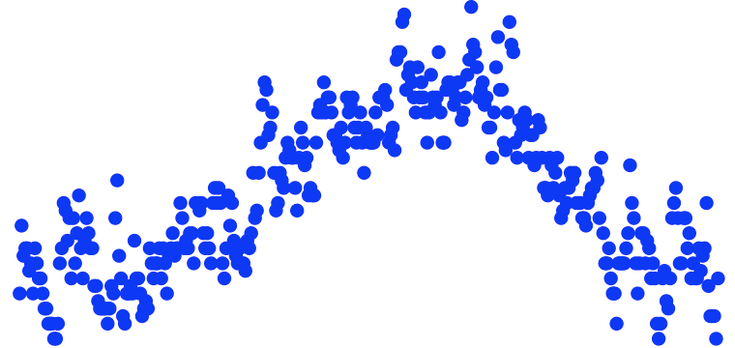
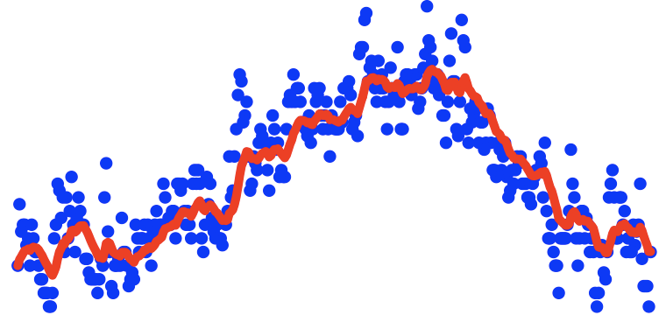





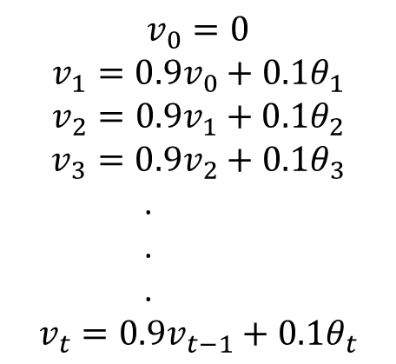
Temperature in London
$θ_{1}=40°F$ $4°C$
$$θ_{2}=49°F 9°C$$
$$θ_{3}=45°F$$
temperature
.
.
.
$$θ_{180}=60°F 15°C$$
$$θ_{181}=56°F$$
days
.
.
$$v_{0}=0$$
$$v_{1}=0.9v_{0}+0.1θ_{1}$$
$$v_{2}=0.9v_{1}+0.1θ_{2}$$
$$v_{3}=0.9v_{2}+0.1θ_{3}$$
.
.
.
$$v_{t}=0.9v_{t−1}+0.1θ_{t}$$
.

Slide 15
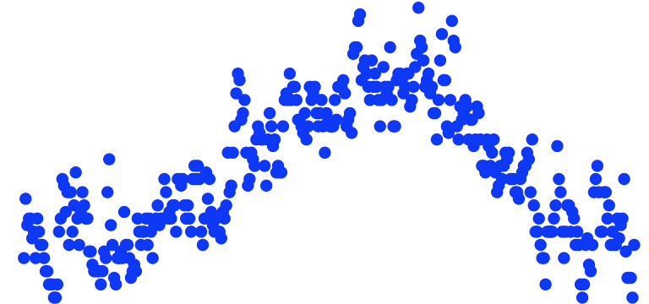
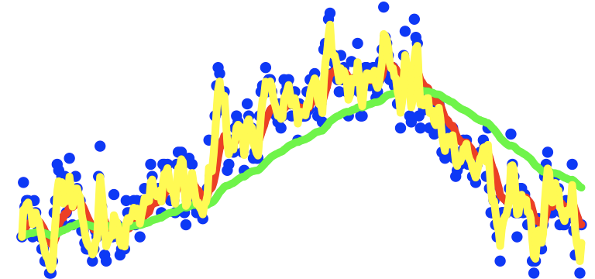
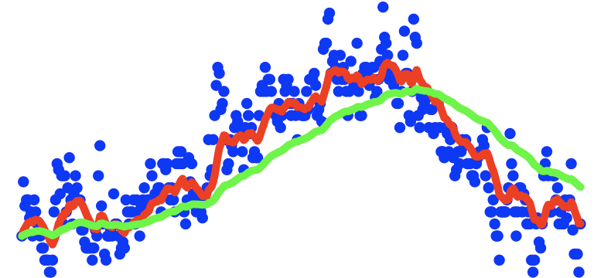
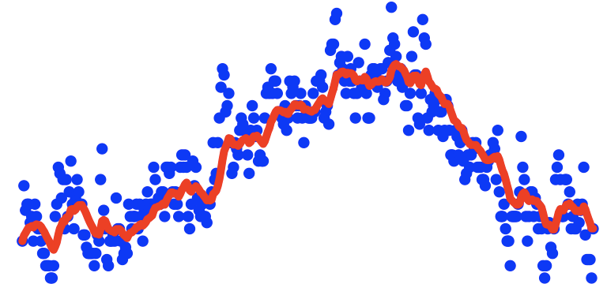

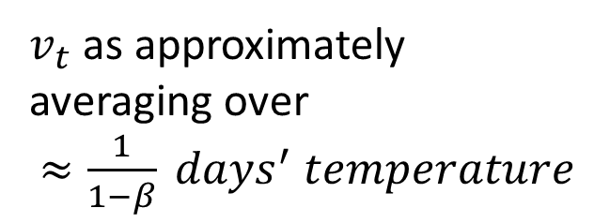
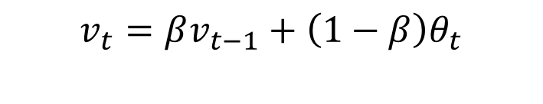

Exponentially weighted averages
moving
$$v_{t}=βv_{t−1}+\left(1−β\right)θ_{t}$$
$v_{t}$ as approximately
averaging over
$≈\frac{1}{1−β} days^{′} temperature$
$$β=0.9: ≈10 days′ temperature$$
$$β=0.98: ≈50 days′ temperature$$
$$β=0.5: ≈2 days′ temperature$$
$$\frac{1}{1−0.98}=50$$
temperature
days

Slide 16
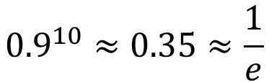













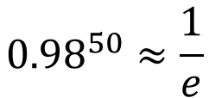









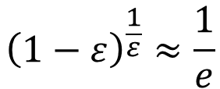



Exponentially weighted averages
$$v_{t}=βv_{t−1}+(1−β)θ_{t}$$
$$×$$
$$×$$
$$×$$
$$θ_{t}$$
$$×$$
$$×$$
$$×$$
$$×$$
$$×$$
$$×$$
$$×$$
| | |
$$t=100$$
$$v_{100}=0.9v_{99}+0.1θ_{100}$$
$$≈\frac{1}{1−β}$$
$$−$$
$$0.1$$
$$v_{99}=0.9v_{98}+0.1θ_{99}$$
$$v_{98}=0.9v_{97}+0.1θ_{98}$$
$$v_{100}$$
$$ε=1−β$$
$$…$$
$$10$$
$${ v}_{100}=0.1θ_{100}+0.9v_{99}$$
$$0.1θ_{98}+0.9v_{97}$$
$${ v}_{100}=0.1θ_{100}+0.9 (0.1θ_{99}+0.9v_{98})=$$
$$=0.1θ_{100}+0.1×0.9θ_{99}+0.1×{\left(0.9\right)}^{2}θ_{98}+0.1×{\left(0.9\right)}^{3}θ_{97}+0.1×{\left(0.9\right)}^{4}θ_{96}+…$$
$${0.9}^{10}≈0.35≈\frac{1}{e}$$
$${\left(1−ε\right)}^{\frac{1}{ε}}≈\frac{1}{e}$$
$${0.98}^{50}≈\frac{1}{e}$$
$$ε=0.02$$

Slide 17

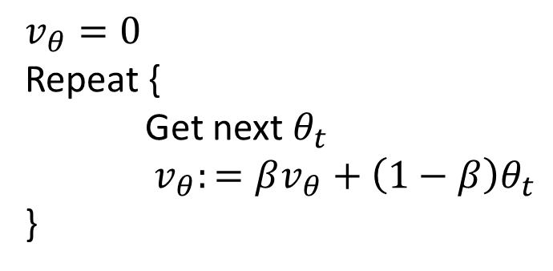




Implementing exponentially weighted averages
$$v_{0}=0$$
$$v_{θ}=0$$
Repeat {
Get next $θ_{t}$
$v_{θ}:=βv_{θ}+\left(1−β\right)θ_{t}$
}
$$v_{1}=βv_{0}+(1−β) θ_{1}$$
$$v_{2}=βv_{1}+(1−β) θ_{2}$$
$$v_{3}=βv_{2}+(1−β) θ_{3}$$
$$…$$

Slide 18
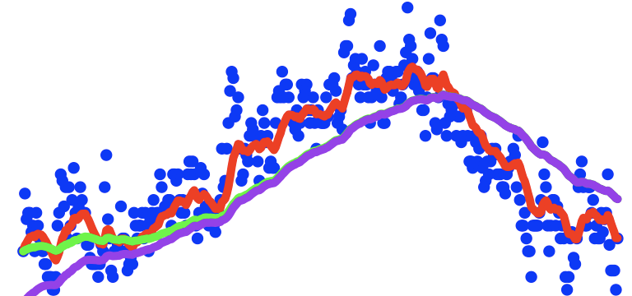

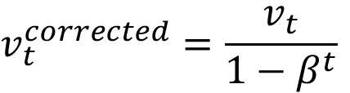

Bias correction
$$β=0.98$$
temperature
days
$$v_{t}=βv_{t−1}+(1−β)θ_{t}$$
$$v_{t}^{corrected}=\frac{v_{t}}{1−β^{t}}$$

Slide 19
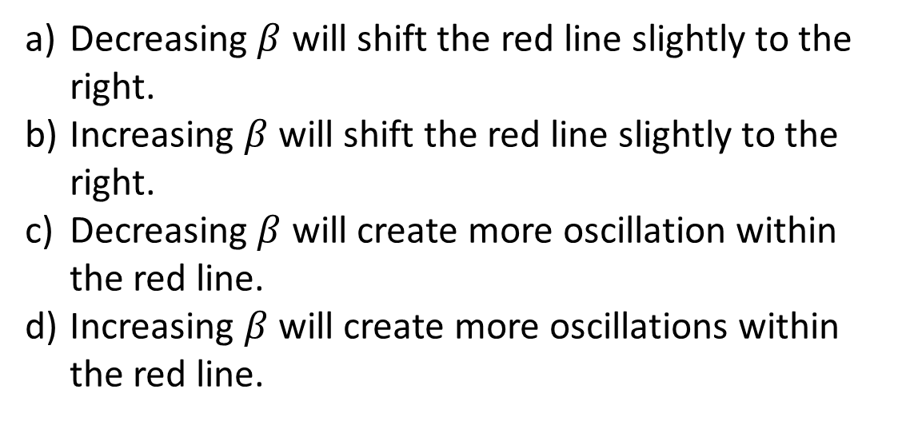
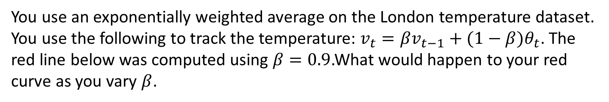
You use an exponentially weighted average on the London temperature dataset. You use the following to track the temperature: $v_{t}=βv_{t−1}+(1−β)θ_{t}$. The red line below was computed using $β=0.9$.What would happen to your red curve as you vary $β$.
Decreasing $β$ will shift the red line slightly to the right.
Increasing $β$ will shift the red line slightly to the right.
Decreasing $β$ will create more oscillation within the red line.
Increasing $β$ will create more oscillations within the red line.

Slide 20
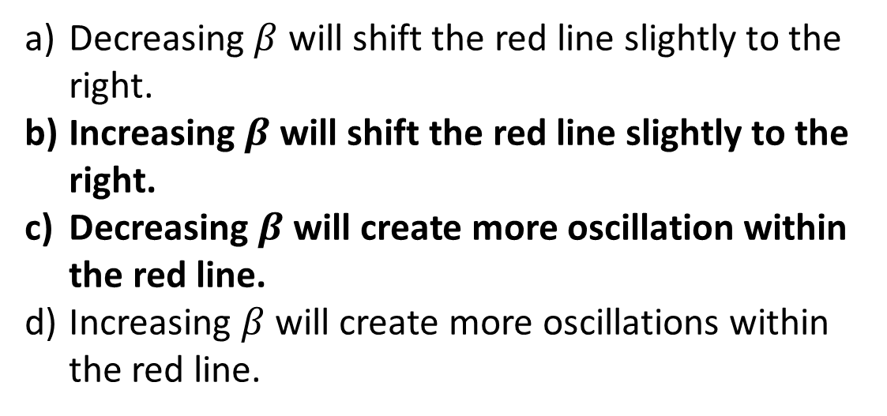
You use an exponentially weighted average on the London temperature dataset. You use the following to track the temperature: $v_{t}=βv_{t−1}+(1−β)θ_{t}$. The red line below was computed using $β=0.9$.What would happen to your red curve as you vary $β$.
Decreasing $β$ will shift the red line slightly to the right.
Increasing $β$ will shift the red line slightly to the right.
Decreasing $β$ will create more oscillation within the red line.
Increasing $β$ will create more oscillations within the red line.

Slide 21
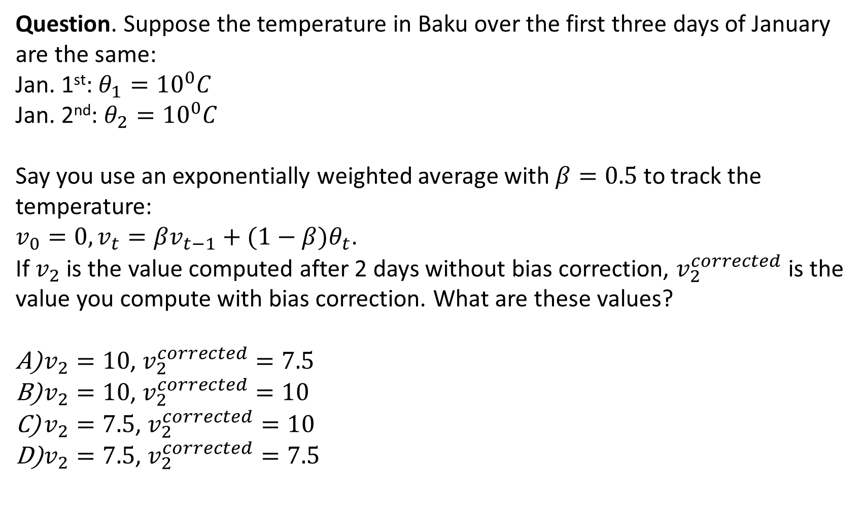
Question. Suppose the temperature in Baku over the first three days of January are the same:
Jan. 1st: $θ_{1}={10}^{0}C$
Jan. 2nd: $θ_{2}={10}^{0}C$
Say you use an exponentially weighted average with $β=0.5$ to track the temperature:
$v_{0}=0,v_{t}=βv_{t−1}+(1−β)θ_{t}$.
If $v_{2}$ is the value computed after 2 days without bias correction, $v_{2}^{corrected}$ is the value you compute with bias correction. What are these values?
$v_{2}=10$, $v_{2}^{corrected}=7.5$
$v_{2}=10$, $v_{2}^{corrected}=10$
$v_{2}=7.5$, $v_{2}^{corrected}=10$
$v_{2}=7.5$, $v_{2}^{corrected}=7.5$

Slide 22
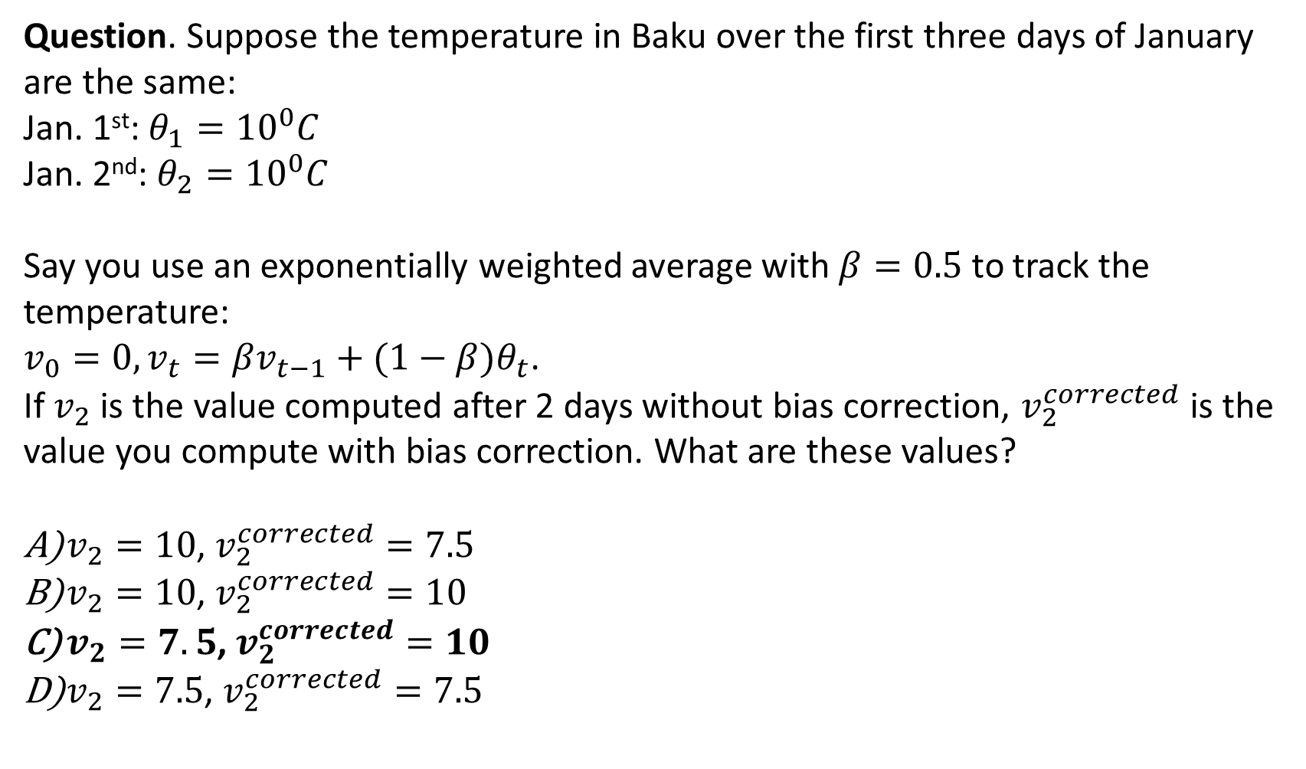
Question. Suppose the temperature in Baku over the first three days of January are the same:
Jan. 1st: $θ_{1}={10}^{0}C$
Jan. 2nd: $θ_{2}={10}^{0}C$
Say you use an exponentially weighted average with $β=0.5$ to track the temperature:
$v_{0}=0,v_{t}=βv_{t−1}+(1−β)θ_{t}$.
If $v_{2}$ is the value computed after 2 days without bias correction, $v_{2}^{corrected}$ is the value you compute with bias correction. What are these values?
$v_{2}=10$, $v_{2}^{corrected}=7.5$
$v_{2}=10$, $v_{2}^{corrected}=10$
$v_{2}=7.5$, $v_{2}^{corrected}=10$
$v_{2}=7.5$, $v_{2}^{corrected}=7.5$

Slide 23
Optimization Algorithms
Gradient descent with momentum
Gradient Descent with Momentum considers the past gradients to smooth out the update. It computes an exponentially weighted average of your gradients, and then use that gradient to update your weights instead. It works faster than the standard gradient descent algorithm.

Slide 24
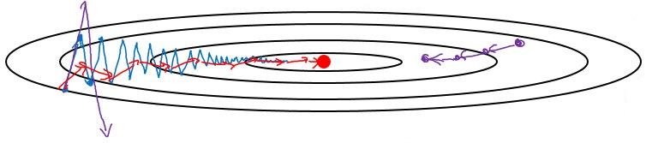

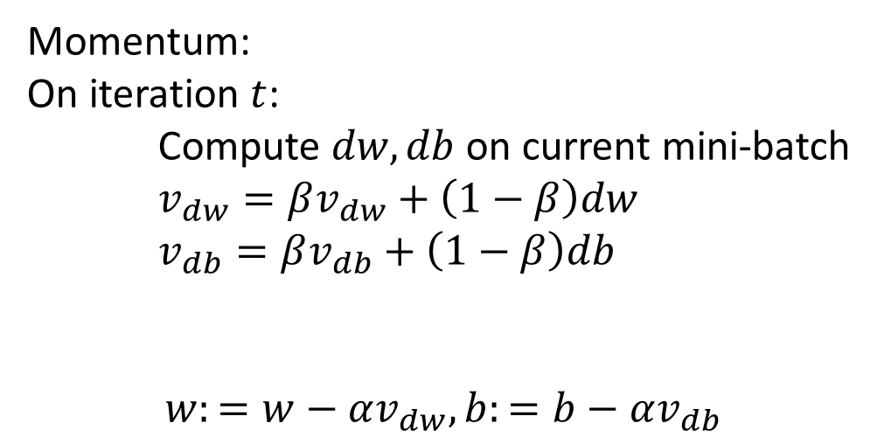

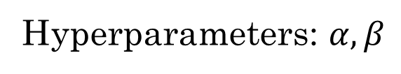
Gradient descent with momentum
slower learning
faster learning
Momentum:
On iteration $t$:
Compute $dw, db$ on current mini-batch
$v_{dw}=βv_{dw}+\left(1−β\right)dw$
$v_{db}=βv_{db}+\left(1−β\right)db$
$$w:=w−αv_{dw}, b:=b−αv_{db}$$
$$v_{t}=βv_{t−1}+(1−β)θ_{t}$$
friction
velocity
acceleration
$$\frac{v_{dw}}{1−β^{t}}$$
Hyperparameters: $α,β$
$β=0.9$ -- average over last $≈10$ gradients

Slide 25

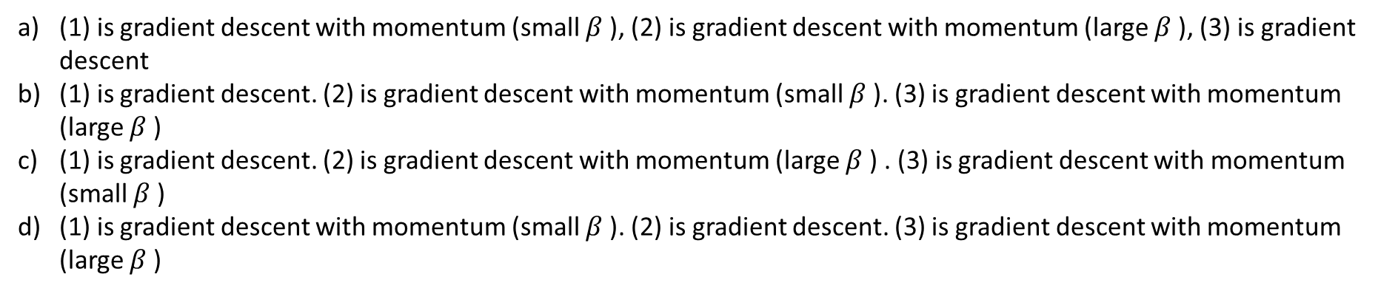
Question. These plots were generated with gradient descent; with gradient descent with momentum ($β$= 0.5) and gradient descent with momentum ($β$= 0.9). Which curve corresponds to which algorithm?
(1) is gradient descent with momentum (small $β$), (2) is gradient descent with momentum (large $β$), (3) is gradient descent
(1) is gradient descent. (2) is gradient descent with momentum (small $β$). (3) is gradient descent with momentum (large $β$)
(1) is gradient descent. (2) is gradient descent with momentum (large $β$) . (3) is gradient descent with momentum (small $β$)
(1) is gradient descent with momentum (small $β$). (2) is gradient descent. (3) is gradient descent with momentum (large $β$)

Slide 26
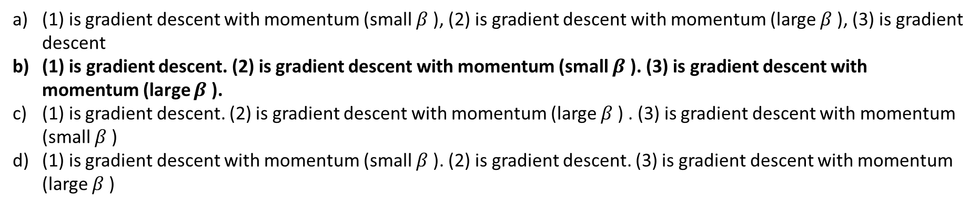
Question. These plots were generated with gradient descent; with gradient descent with momentum ($β$= 0.5) and gradient descent with momentum ($β$= 0.9). Which curve corresponds to which algorithm?
(1) is gradient descent with momentum (small $β$), (2) is gradient descent with momentum (large $β$), (3) is gradient descent
(1) is gradient descent. (2) is gradient descent with momentum (small $β$). (3) is gradient descent with momentum (large $β$).
(1) is gradient descent. (2) is gradient descent with momentum (large $β$) . (3) is gradient descent with momentum (small $β$)
(1) is gradient descent with momentum (small $β$). (2) is gradient descent. (3) is gradient descent with momentum (large $β$)

Slide 27
Optimization Algorithms
RMSprop
RmsProp is an optimizer that utilizes the magnitude of recent gradients to normalize the gradients. We always keep a moving average over the root mean squared gradients, by which we divide the current gradient.

Slide 28
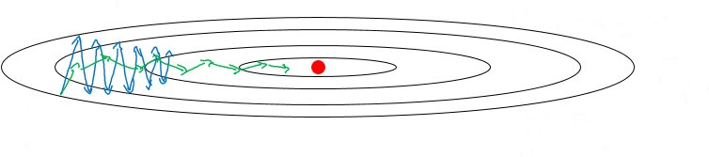
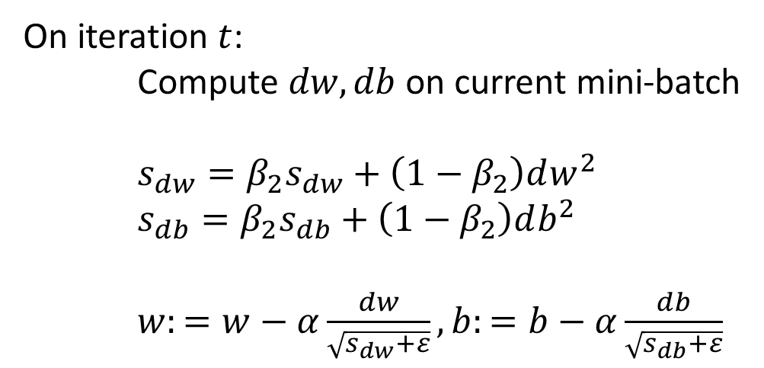



RMSprop
$$b$$
$$w$$
slow
On iteration $t$:
Compute $dw, db$ on current mini-batch
$s_{dw}=β_{2}s_{dw}+\left(1−β_{2}\right)dw^{2}$
$s_{db}=β_{2}s_{db}+\left(1−β_{2}\right)db^{2}$
$w:=w−α\frac{dw}{\sqrt{s_{dw}+ε}}, b:=b−α\frac{db}{\sqrt{s_{db}+ε}}$
fast
element-wise
small
large
$$ε={10}^{−8}$$

Slide 29
Optimization Algorithms
Adam optimization algorithm
Adam combines the best properties of the Momentum and RMSProp algorithms to provide an optimization algorithm that can handle sparse gradients on noisy problems.

Slide 30
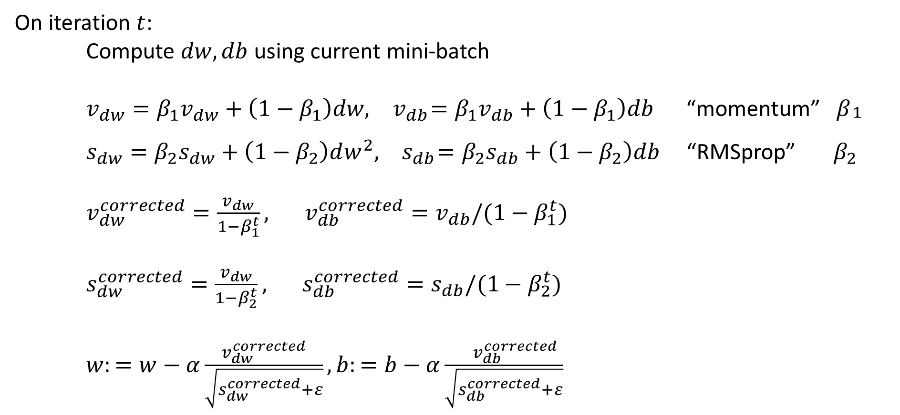
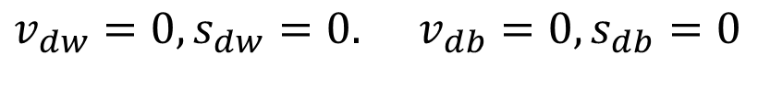
Adam optimization algorithm
$$v_{dw}=0,s_{dw}=0. v_{db}=0,s_{db}=0$$
On iteration $t$:
Compute $dw, db$ using current mini-batch
$v_{dw}=β_{1}v_{dw}+\left(1−β_{1}\right)dw,{ v}_{db}=β_{1}v_{db}+\left(1−β_{1}\right)db$ “momentum” ${ β}_{\begin{aligned}1 \\ \end{aligned}}$
$s_{dw}=β_{2}s_{dw}+\left(1−β_{2}\right)dw^{2},{ s}_{db}=β_{2}s_{db}+\left(1−β_{2}\right)db$ “RMSprop” $β_{2}$
$v_{dw}^{corrected}=\frac{v_{dw}}{1−β_{1}^{t}}, { v}_{db}^{corrected}=v_{db}/(1−β_{1}^{t})$
$s_{dw}^{corrected}=\frac{v_{dw}}{1−β_{2}^{t}}, { s}_{db}^{corrected}=s_{db}/(1−β_{2}^{t})$
$w:=w−α\frac{v_{dw}^{corrected}}{\sqrt{s_{dw}^{corrected}+ε}}, b:=b−α\frac{{ v}_{db}^{corrected}}{\sqrt{s_{db}^{corrected}+ε}}$

Slide 31
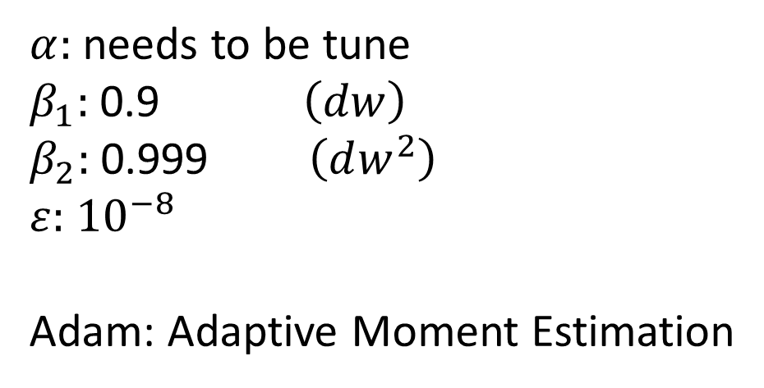
Hyperparameters choice:
$α:$ needs to be tune
$β_{1}:$ 0.9 $\left(dw\right)$
$β_{2}:$ 0.999 $\left(dw^{2}\right)$
$ε:$ ${10}^{−8}$
Adam: Adaptive Moment Estimation

Slide 32
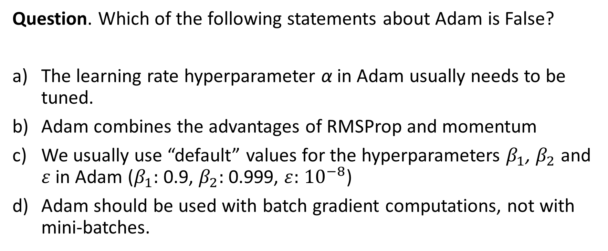
Question. Which of the following statements about Adam is False?
The learning rate hyperparameter α in Adam usually needs to be tuned.
Adam combines the advantages of RMSProp and momentum
We usually use “default” values for the hyperparameters $β_{1}$, $β_{2}$ and $ε$in Adam ($β_{1}:$ 0.9, $β_{2}:$ 0.999, $ε:$ ${10}^{−8}$)
Adam should be used with batch gradient computations, not with mini-batches.

Slide 33
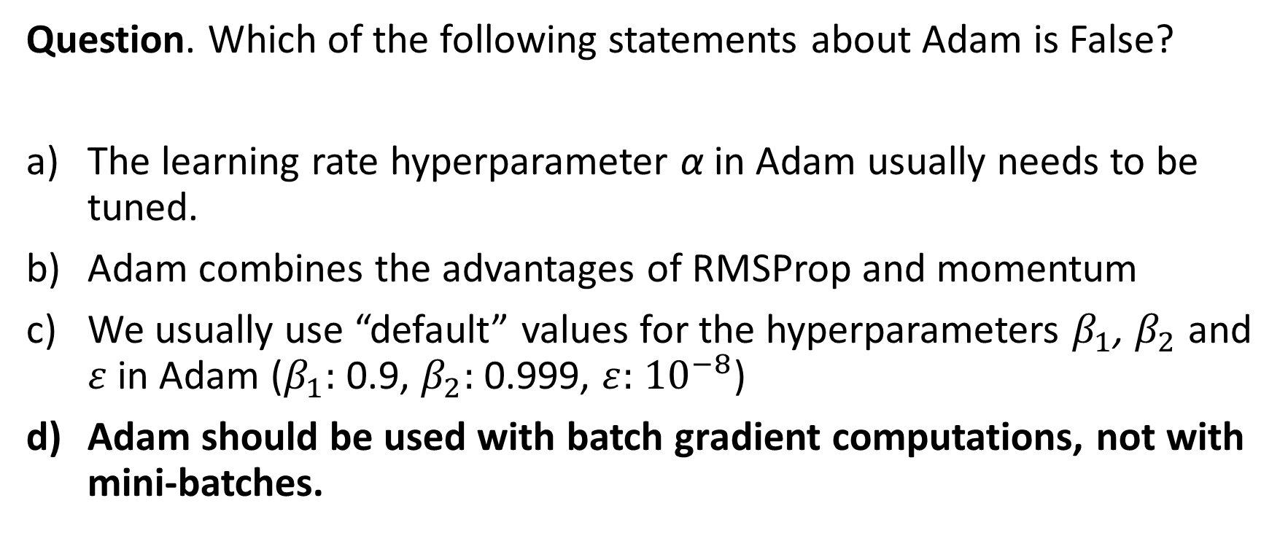
Question. Which of the following statements about Adam is False?
The learning rate hyperparameter α in Adam usually needs to be tuned.
Adam combines the advantages of RMSProp and momentum
We usually use “default” values for the hyperparameters $β_{1}$, $β_{2}$ and $ε$in Adam ($β_{1}:$ 0.9, $β_{2}:$ 0.999, $ε:$ ${10}^{−8}$)
Adam should be used with batch gradient computations, not with mini-batches.

Slide 34
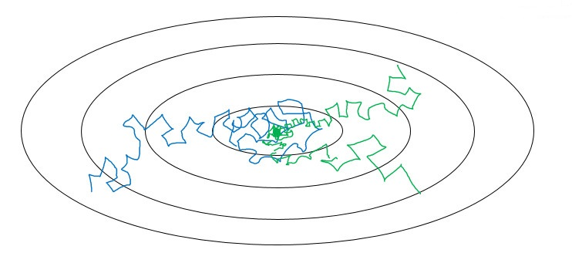
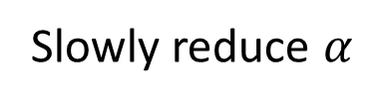
Learning rate decay
Slowly reduce $α$

Slide 35
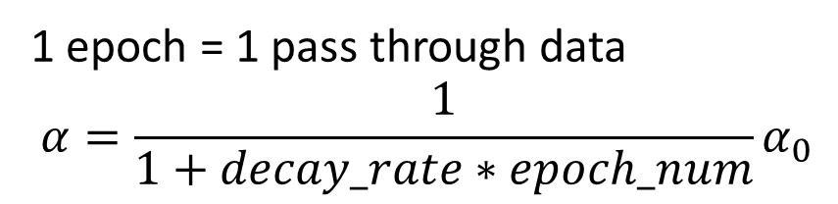



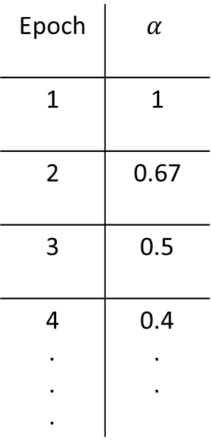
How to choose $α$ Learning rate decay
$$x^{\{1\}}$$ | $$x^{\{2\}}$$ | …
epoch 1
1 epoch = 1 pass through data
$$α=\frac{1}{1+decay_rate∗epoch_num}α_{0}$$
epoch 2
.
.
.
Epoch | $$α$$
1 | 1
2 | 0.67
3 | 0.5
4 . . . | 0.4 . .
$$α_{0}=2$$
$$decay_rate=1$$

Slide 36

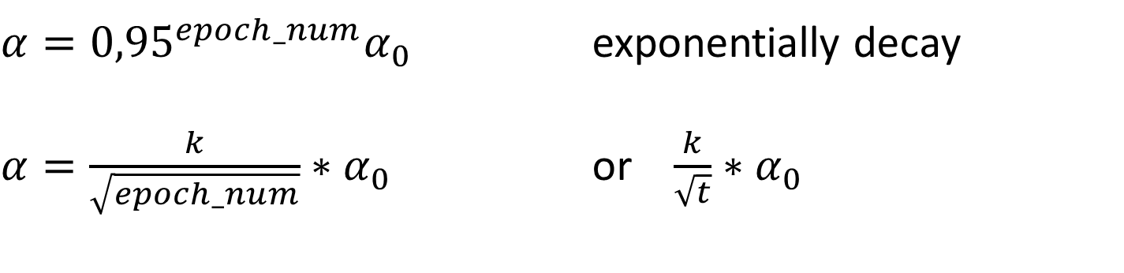

Other learning rate decay methods
$α={0,95}^{epoch_num}α_{0}$ exponentially decay
$α=\frac{k}{\sqrt{epoch_num}}∗α_{0}$ or $\frac{k}{\sqrt{t}}∗α_{0}$
$$α$$
discrete staircase
$$t$$
Manual decay

Slide 37

Question. Which of these is NOT a good learning rate decay scheme? Here, t is the epoch number.
A) $α=\frac{1}{1+2∗t}α_{0}$
B) $α={0,95}^{t}α_{0}$
C) $α=\frac{1}{\sqrt{t}}α_{0}$
D) $α=e^{t}α_{0}$

Slide 38

Question. Which of these is NOT a good learning rate decay scheme? Here, t is the epoch number.
A) $α=\frac{1}{1+2∗t}α_{0}$
B) $α={0,95}^{t}α_{0}$
C) $α=\frac{1}{\sqrt{t}}α_{0}$
D) $α=e^{t}α_{0}$

Slide 39
Question. Suppose batch gradient descent in a deep network is taking excessively long to find a value of the parameters that achieves a small value for the cost function J. Which of the following techniques could help find parameter values that attain a small value for J? (Check all that apply)
Try using Adam
Try tuning the learning rate α
Try better random initialization for the weights
Try mini-batch gradient descent
Try initializing all the weights to zero

Slide 40
Question. Suppose batch gradient descent in a deep network is taking excessively long to find a value of the parameters that achieves a small value for the cost function J. Which of the following techniques could help find parameter values that attain a small value for J? (Check all that apply)
Try using Adam
Try tuning the learning rate α
Try better random initialization for the weights
Try mini-batch gradient descent
Try initializing all the weights to zero

Slide 41
Reading materials.
Machine Learning yearning. Andrew Ng. 2018.
https://www.deeplearning.ai/machine-learning-yearning/
MLP classifier. https://scikit-learn.org/stable/modules/generated/sklearn.neural_network.MLPClassifier.html#sklearn.neural_network.MLPClassifier

